Slide 1
Doing Hoops With Hadoop (and friends)
Greg Rogers
Systems Performance & Capacity Planning
Financial Services Industry
(formerly DEC, Compaq, HP, MACP Consulting)
Hewlett-Packard Enterprise Systems Division
2 August 2012

Slide 2
What’s all the excitement about?
In a phrase:
Big Data
Analytics
Data science: Develop insights from Big Data
Often statistical, often centered around Clustering and Machine Learning
Big Brother Is Watching You (BBIWY)
Governments? Corporations? Criminals?
Somebody else’s presentation topic!
Bruce Schneier, et al
Cloud Computing
Public: Amazon, et al, low-cost prototyping for startup companies
Elastic Compute Cloud (EC3)
Simple Storage Service (S3)
EBS
Hadoop services
Private
Grid or Cluster computing

Slide 3

Say hello to Hadoop

Slide 4

One more time

Slide 5










Say hello to Hadoop’s friends a.k.a. The Hadoop Ecosystem ca. 2011-2012

Slide 6
Overloading Terminology
Hadoop has become synonymous with Big Data management and processing
The name Hadoop is also now a proxy for both Hadoop and the large, growing ecosystem around it
Basically, a very large “system” using Hadoop Distributed File System (HDFS) for storage, and direct or indirect use of the MapReduce programming model and software framework for processing

Slide 7



Hadoop: The High Level
Apache top-level project
“…develops open-source software for reliable, scalable, distributed computing.”
Software library
“…framework that allows for distributed processing of large data sets across clusters of computers using a simple programming model…designed to scale up from single servers to thousands of machines, each offering local computation and storage…designed to detect and handle failures at the application layer…delivering a highly-available service on top of a cluster of computers, each of which may be prone to failures.”
Hadoop Distributed File System (HDFS)
“…primary storage system used by Hadoop applications. HDFS creates multiple replicas of data blocks and distributes them on compute nodes throughout a cluster to enable reliable, extremely rapid computations.”
MapReduce
“…a programming model and software framework for writing applications that rapidly process vast amounts of data in parallel on large clusters of compute nodes.”

Slide 8
What’s Hadoop Used For? Major Use Cases per Cloudera (2012)
Data processing
Building search indexes
Log processing
“Click Sessionization”
Data processing pipelines
Video & Image analysis
Analytics
Recommendation systems (Machine Learning)
Batch reporting
Real time applications (“home of the brave”)
Data Warehousing

Slide 9

HDFS
Google File System (GFS) cited as the original concept
Certain common attributes between GFS & HDFS
Pattern emphasis: Write Once, Read Many
Sound familiar?
Remember WORM drives? Optical jukebox library? Before CDs (CD-R)
Back when dirt was new… almost…
WORM optical storage was still about greater price:performance at larger storage volumes vs. the prevailing [disk] technology – though still better p:p than The Other White Meat of the day, Tape!
Very Large Files: One file could span the entire HDFS
Commodity Hardware
2 socket; 64-bit; local disks; no RAID
Co-locate data and compute resources

Slide 10
HDFS: What It’s Not Good For
Many, many small files
Scalability issue for the namenode (more in a moment)
Low Latency Access
It’s all about Throughput (N=XR)
Not about minimizing service time (or latency to first data read)
Multiple writers; updates at offsets within a file
One writer
Create/append/rename/move/delete - that’s it! No updates!
Not a substitute for a relational database
Data stored in files, not indexed
To find something, must read all the data (ultimately, by a MapReduce job/tasks)
Selling SAN or NAS – NetApp & EMC need not apply
Programming in COBOL
Selling mainframes & FICON

Slide 11

HDFS Concepts & Architecture
Core architectural goal: Fault-tolerance in the face of massive parallelism (many devices, high probability of HW failure)
Monitoring, detection, fast automated recovery
Focus is batch throughput
Hence support for very large files; large block size; single writer, create or append (no update) and a high read ratio
Master/Slave: Separate filesystem metadata & app data
One NameNode manages the filesystem and client access
All metadata - namespace tree & map of file blocks to DataNodes - stored in memory and persisted on disk
Namespace is a traditional hierarchical file organization (directory tree)
DataNodes manage locally attached storage (JBOD, no RAID)
Not layered on or dependent on any other filesystem

Slide 12
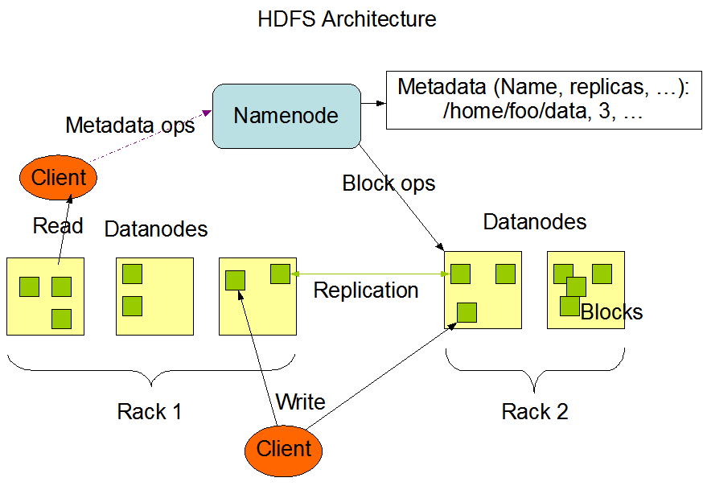
http://hadoop.apache.org/common/docs/current/hdfs_design.html

Slide 13
HDFS Concepts & Architecture
Block-oriented
Not your father’s block size: 64 MB by default
Block size selectable on a file-by-file basis
What if an HDFS block was 512 bytes or 4KB instead of 64 MB?
Metadata would be 128K (131,072) times or 16K (16,384) times larger, impacting memory on NameNode and potentially limiting the total HDFS storage size in the cluster
Total storage also sensitive to total number of files in HDFS
All blocks in a file are the same size, except the last block
Large block size minimizes seek time
Approaches disk spiral transfer rate ~100 MB/sec
Disk read-ahead may further minimize track to track seek time
High aggregate file read bandwidth, # disks/node X 100 GB/sec
Divides incoming files into blocks, storing them redundantly across DataNodes in the cluster: Replication for fault-tolerance
Replication Factor per-file
Location of block replicas can change over time

Slide 14

HDFS
Built with Java
Typically runs on a Linux distribution
But it’s Java…

Slide 15
NameNode
Is a SPOF, single point of failure
Metadata persisted in the file FsImage
Changes since last checkpoint logged separately in a transaction log called the EditLog
Both files stored in NameNodes’s local filesystem
Availability: Redundant copies to NAS or other servers
Counter-intuitive:
Checkpoint done only at NameNode startup
EditLog read to update FsImage; FsImage mapped into memory; EditLog truncated; ready to rock!
The NameNode does not directly call DataNodes but piggy-backs instructions in its replies to DataNodes’ heartbeat
Replicate blocks to other nodes (pipeline approach)
Remove block replicas (load balancing)
Restart (re-register, re-join cluster) or shutdown
Send a block report NOW

Slide 16
DataNodes
A block replica is made up of 2 files on a DataNode’s local file system
The data itself
Block metadata
Block checksum and generation timestamp
At startup the DataNode connects to the NameNode & performs a handshake to verify ID and version
Shutdown if either does not match: Prevent corruption
Nodes cannot “register” with NameNode; i.e., join the cluster unless they have a matching ID
Blocks consume only the space needed
Hadoop optimizes for full blocks until the last block of the file is written

Slide 17
DataNodes (cont’d)
Sends a block report to the NameNode about all block replicas it contains, at DataNode “startup” and hourly
Sends heartbeat to NameNode @ 3 sec intervals (default)
10 minute timeout, DataNode removed by NameNode and new replicas of its blocks scheduled for creation on other DataNodes
Heartbeat also contains info used by NameNode’s storage allocation and load balancing algorithms

Slide 18
Back to the NameNode
Filesystem metadata is persisted in the file “FsImage”
Changes since last checkpoint logged separately in a transaction log called the “EditLog”
Both files stored in NameNodes’s local filesystem
Availability: Redundant copies to NAS or other servers
Counter-intuitive:
Checkpoint done only at NameNode startup
Replay EditLog to update FsImage; FsImage mapped into memory; EditLog truncated; ready to rock!

Slide 19
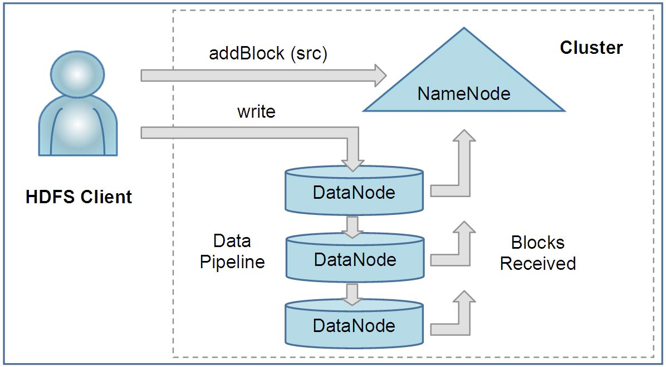
Client Read & Write
Client read request first contacts the NameNode for locations of file data blocks; reads blocks from closest DataNode(s)
Uses block checksum to detect corruption, a common problem in clusters of 100s-1,000s of nodes and disks
Client write operation sends path to NameNode; requests NameNode to select Replication Factor number of DataNodes to host block replicas; writes data to DataNodes in serial pipeline manner (more in a moment)
File create:

Slide 20
Client Write (cont’d)
Write Pipeline
Data bytes pushed to the pipeline as a sequence of packets
Client buffers bytes until a packet buffer fills (64KB default) or until file is closed, then packet is pushed into the pipeline
Client calculates & sends checksum with block
Recall that data and metadata (incl. checksum) are stored separately on DataNode
Asynchronous I/O
Client does not wait for ACK to packet by DataNode, continues pushing packets
Limit to the # of outstanding packets = “packet window size” of client
i.e., the queue size (N=XR)
Data visible to new reader at file close or using hflush call

Slide 21
HDFS Key Points
Locality and High Performance
HDFS is atypical of conventional non-distributed file systems in that its API exposes the location of a file’s blocks, with major implications
Frameworks like MapReduce can thus schedule a task to execute where the data is located
Send computation to the data, not the other way around
Reduces network infrastructure costs, reduces elapsed time
Highest read performance when a task executes with data on local disks
Point-to-point SAS/SATA disks, no shared bus, a key technology enabler
Massive price : performance benefit over SAN storage
Supports application per-file replication factor (default 3)
Improves fault tolerance
Increases read bandwidth for heavily accessed files

Slide 22
Typical Hadoop Node
Dual socket 1U/2U rack mount server
Internal disk requirement negates use of blades
Quad core CPUs >2 GHz
16-24 GB memory
4 to 6 data disks @ 1TB
Performance & economics target for heavily queried data, busy processors
Use cases focusing on long-term storage might deploy a DL370 5U form factor with 14 internal 3.5” disks
1 GbE NIC
Linux

Slide 23

Hadoop MapReduce
Software framework for “easily” writing applications that process vast (multi-TB) amounts of data in parallel on very large clusters of commodity hardware with reliability and fault-tolerance
A MapReduce job normally divides the input data into separate chunks which are then processed in parallel by Map tasks. The framework guarrantees Map output is sorted for input to Reduce
The sorted outputs are inputs to the Reduce tasks
Input and output are stored in HDFS
Framework performs task scheduling; task monitoring & re-execution of failed tasks
Massive aggregate cluster bandwidth
# nodes X # disks X ~100 MB/sec

Slide 24
Language Support
Java (native)
Streaming
Any language supporting Unix STREAMS interface
Read from stdin, write to stdout
Redirection as usual
Highly suited to text processing
Line by line input
Key-value pair output of Map program written as tab-delimited line to stdout
MapReduce Framework sorts the Map task output
Reduce function reads sorted lines from stdin
Reduce finally writes to stdout
Python; Perl; Ruby; etc.
Pipes
The C++ interface for MapReduce
Sockets interface (not streams, not java native interface JNI)

Slide 25
Hadoop MapReduce
Master/Slave architecture
One master Jobtracker in the cluster
One slave Tasktracker per DataNode
Jobtracker
Schedules a job’s constituent tasks on slaves
Monitors tasks, re-executes upon task failure
Tasktracker executes tasks by direction of the Jobtracker

Slide 26
Hadoop MapReduce Job Execution
Client MapReduce program submits job through JobClient.runJob API
Job Client (in client JVM on client node) sends request to JobTracker (on JobTracker node), which will coordinate job execution in the cluster
JobTracker returns Job ID
JobClient calculates splits of input data
JobClient “fans the job out” to multiple systems
Copies program components (Java jar, config file) and calculated input data splits to JobTracker’s filesystem. Write (default) 10 copies of this to 10 JobTrackers (recall JobTracker is one per DataNode)
JobTracker inserts job into its queue for its scheduler to dequeue and init
Init: Create job object to represent tasks it executes, and track task progress/status
JobClient informs JobTracker that job is ready to execute
JobTracker creates list of tasks to run
Retrieves (from HDFS) the input data splits computed by JobClient
Creates one Map task per data split

Slide 27
TaskTracker
TaskTrackers communication with JobTracker
Default loop, sends periodic heartbeat message to JobTracker
Tasktracker is alive
Available (or not) to run a task
JobTracker sends task to run in heartbeat response message if TaskTracker available
TaskTrackers have limited queue size for Map and for Reduce tasks
Queue size mapped to # cores & physical memory on TaskTracker node
TaskTracker scheduler will schedule Map tasks before Reduce tasks
Copies jar file from HDFS to TaskTracker filesystem
Unwinds jar file into a local working directory create for task
Creates TaskRunner to run the task
TaskRunner starts a JVM for each task
Separate JVM per task isolates TaskTracker from user M/R program bugs

Slide 28
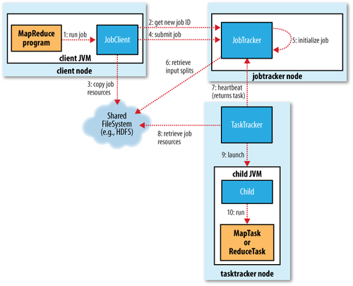

Slide 29
TaskTracker
TaskTracker per-task JVM (children) communicate to parent
Status, progress of each task, every few seconds via “umbilical” interface
Streaming interface communicates with process via stdin/stdout
MapReduce jobs are long-running
Minutes to hours
Status and progress important to communicate
State: Running, successful completion, failed
Progress of map & reduce tasks
Job counters
User-defined status messages
Task Progress: How is this defined?
Input record read (Map or Reduce)
Output record written
Set status description on Reporter, increment Reporter counter, call to Reporter progress() method

Slide 30
Job Completion
JobTracker receives last task’s completion notification
Changes job status to “successful”
Can send HTTP job notification message to JobClient
JobClient learns of success at its next polling interval to JobTracker
Sends message to user
JobTracker performs cleanup, commands TaskTrackers to cleanup

Slide 31
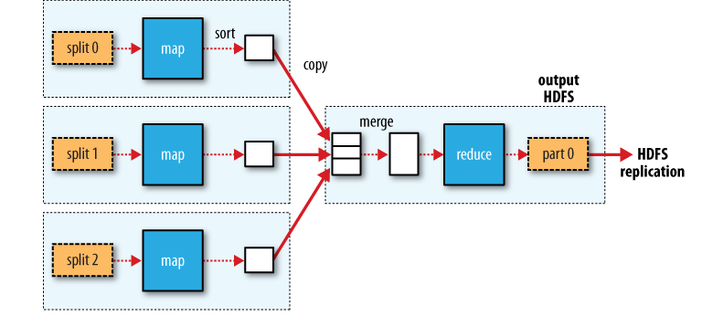
Example Job & Filesystem Interaction Multiple Map tasks, one Reduce task Map reads from HDFS, writes to local FS Reduce reads from local FS, writes to HDFS

Slide 32
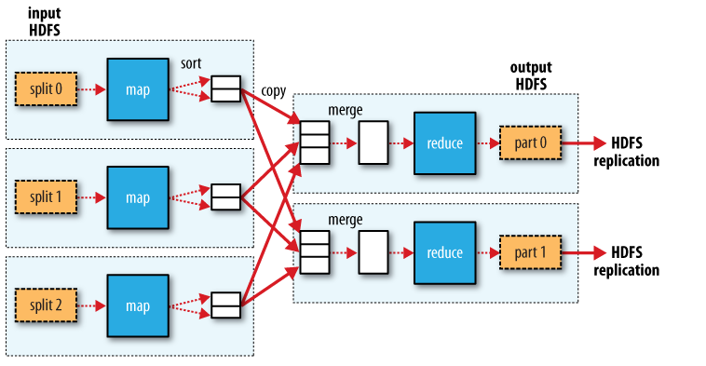
Example # Job & Filesystem Interaction Multiple Map tasks, Two Reduce tasks Each Reduce writes one partition per Reduce task to HDFS

Slide 33
Sorting Map Output
Default 100 MB memory buffer in which to sort output of a Map tasks’s output
Sort thread divides output data into partitions by the Reducer the output will be sent to
Within a partition, a thread sorts in-memory by key. Combiner function uses this sorted output
@ default 80% buffer full, starts to flush (“spill”) to the local file system
In parallel, Map outputs continue to be written into the sort buffer while spill writes sorted output to the local FS. Map will block writing to the sort buffer @ 80% full (default)
New spill file created every time buffer hits 80% full
Multiple spill files are merged into one partitioned, sorted output
Output is typically compressed for write to disk (good tradeoff given CPU speed vs. disk speed)
Map output file is now on local disk of tasktracker that ran the Map task

Slide 34
Example # Job & Filesystem Interaction Multiple Map tasks, Two Reduce tasks Each Reduce writes one partition per Reduce task to HDFS

Slide 35
MapReduce Paradigm
MapReduce is not always the best algorithm
One simple functional programming operation applied in parallel to Big Data
Not amenable to maintaining state (remembering output from a previous MapReduce job)
Can pipeline MR jobs in serial
HBase

Slide 36

Apache Hive!
Data warehouse system providing structure onto HDFS
SQL-like query language, HiveQL
Also supports traditional map/reduce programs
Popular with data researchers
Bitly; LinkedIn to name two
Originated & developed at Facebook

Slide 37
Apache Pig!
High-level language for data analysis
Program structure “…amenable to substantial parallelization”
“Complex tasks comprised of multiple interrelated data transformations are explicitly encoded as data flow sequences, making them easy to write, understand, and maintain.”
Popular with data researchers who are also skilled in Python as their analysis toolset and “glue” language
Originated & developed at Yahoo!

Slide 38

Apache HBase!
Realtime, Random R/W access to Big Data
Column-oriented
Modeled after Google’s Bigtable for structured data
Massive distributed database layered onto clusters of commodity hardware
Goal: Very large tables, billions of rows X millions of columns
HDFS underlies HBase
Originally developed at Powerset; acquired by Microsoft

Slide 39

Apache Zookeeper!
Goal: Provide highly reliable distributed coordination services via a set of primitives for distributed apps to build on
“Because Coordinating Distributed Systems is a Zoo” (!)
Common distributed services notoriously difficult to develop & maintain on an application by application basis
Centralized distributed synchronization; group services; naming; configuration information
High performance, highly available, ordered access
In memory. Replicated. Synchronization at client by API
Originated & developed at Yahoo!

Slide 40

Apache Mahout!
Machine Learning Library
Based on Hadoop HDFS & Map/Reduce
Though not restricted to Hadoop implementations
“Scalable to ‘reasonably large’ data sets”
Four primary ML use cases, currently
Clustering; Classification; Itemset Frequency Mining; Recommendation Mining

Slide 41
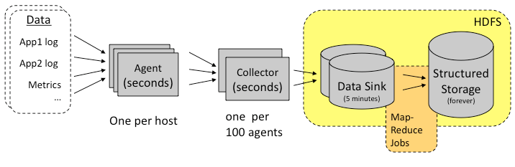
Apache Chukwa! Originated & developed @ Yahoo!
Log analysis framework built on HDFS & Map/Reduce and HBase
Data collection system to monitor large distributed systems
Toolkit for displaying & analyzing collected data
A competitor to Splunk?

Slide 42

Apache Avro! Originated @ Yahoo!, co-developer Cloudera
Data serialization system
Serialization: “…the process of converting a data structure or object state into a format that can be stored” in a file or transmitted over a network link.
Serializing an object is also referred to as “marshaling” an object
Supports JSON as the data interchange format
JavaScript Object Notation, a self-describing data format
Experimental support for Avro IDL, an alternate Interface Description Lang.
Includes Remote Procedure Call (RPC) in the framework
Communication between Hadoop nodes and from clients to services
Hadoop (Doug Cutting) emphasizes moving away from text APIs to using Avro APIs for Map/Reduce, etc.

Slide 43

Apache Whirr!
Libraries for running cloud services
Cloud-neutral, avoids provider idiosyncrasies
Command line tool for deploying large clusters
Common service API
Smart defaults for services to enable quickly getting a properly configured system running but still specify the desired attributes

Slide 44


“Sqoop is a tool designed for efficiently transferring bulk data between Apache Hadoop and structured datastores such as relational databases”
Project status:

Slide 45
Apache Bigtop!
Bigtop is to Hadoop as Fedora is to Red Hat Enterprise Linux
Packing & interoperability testing focuses on the system as a whole vs. individual projects

Slide 46
HCatalog; MRUnit; Oozie
HCatalog
Table and storage management service for data created using Apache Hadoop
Table abstraction with regard to where or how the data is stored
To provide interoperability across data processing tools including Pig; Map/Reduce; Streaming; Hive
MRUnit
Library to support unit testing of Hadoop Map/Reduce jobs
Oozie
Workflow system to manage Hadoop jobs by time or data arrival

Slide 47

Small sample of awareness being raised
Big Data
Science, one of the two top peer-review science journals in the world
11 Feb 2011 Special Issue: Dealing with Data
The Economist
Hadoop-specific
Yahoo! videos on YouTube
Technology pundits in many mainline publications & blogs
Serious blogs by researchers & Ph.D. candidates across data science; computer science; statistics & other fields

Slide 48
Bibliography
Hadoop: The Definitive Guide, 2nd ed. ©October 2010 Tom White (Yahoo!)
Apache Hadoop project page, HDFS Architecture Guide, 10/7/2011
“The Google File System”, ©2003 Ghemawat, et al. ACM Symposium On Operating System Principles
“The Hadoop Distributed File System”, ©2010 Konstantin Svachko, et al (Yahoo!)
“ Scaling Hadoop to 4000 Nodes at Yahoo! ”, 9/30/2008 A. Anand, Yahoo!
Apache project pages: Pig; Hive; HBase; Zookeeper; Avro; etc.
Doug Cutting presentations on Avro & Hadoop ecosystem (slideshare.net)
Cloudera.com
Talk by Pete Skomoroch, Principal Data Scientist, LinkedIn

Slide 49
Data Scientists
“Obtain, scrub, explore, model, interpret”
Hilary Mason & Chris Wiggins, “A Taxonomy of Data Science” (Dataists blog)
What a data scientist does: 5 areas
Knows how to obtain a sufficient body of usable data from multiple sources, requiring different query syntax
At minimum, know how to do this from the command line; e.g., Unix environment
Learn a programming or scripting language that can support automation of retrieval with asynchronous calls and manage the resulting data (Mason prefers Python as of Q4 2010)
Data cleaning (scrubbing) is always necessary before analysis of the data is possible
Least sexy part of analysis process but often yields the greatest benefits
Simple analysis of clean data often more productive than complex analysis of noisy, irregular data
grep, awk, sed for small tasks; Perl or Python adequate for the rest
Familiarity with databases; query syntax; data representation (e.g., JSON; XML; etc.)
Explore: Visualizing; clustering; dimensionality reduction are all part of “looking at data”
Look at your data! Yes, with UNIX utilities: more; less; head; awk; cut
Histograms (selection of bin size makes them an art project rather than “analytics”) & Scatter Plots
Dimension reduction: Principle Components; Partial Least Squares regression (PLS); Multidimensional Scaling
Clustering, unsupervised machine learning techniques for grouping observations
Models: Always bad, sometimes ugly
George E.P. Box: “All models are wrong, but some are useful”
Evaluate many models and find the “least bad”, the least complex having greatest predictive power
Interpret
Domain expertise & intuition often trump technical or software expertise

Slide 50
Remaining Relevant: It’s A Mindset
Stay curious
Explore
Experiment

